Slide 1

Concept 3 – Program Testing Approaches

Slide 2
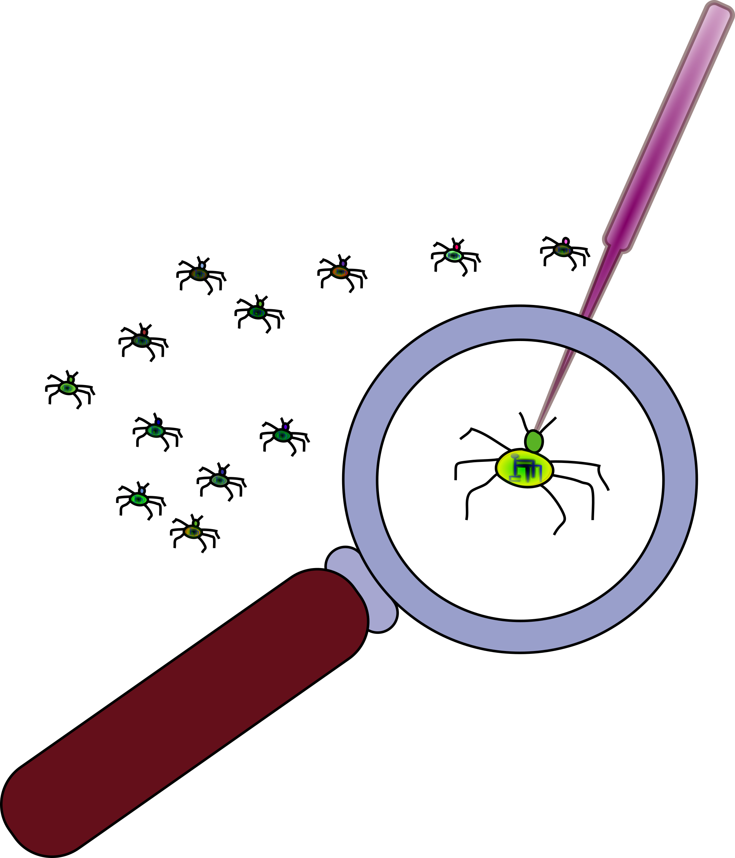
Testing
Write small methods and test often
Test each method as it is written, either by calling the method alone or running the system after each method is created
This limits the scope of an introduced bug.
If you write a lot of code, and test after, the bug could be anywhere
Debugging is the worst job in programming

Slide 3
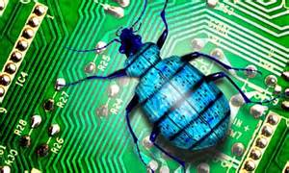
Test First Design
Best practice is test first. Write test cases before any code, so you know what your code needs to do
Industry uses testing tools (defined inputs and expected behaviour of methods)
Many programmers make changes, the system is rebuilt and tested for integrity using a test harness that checks
Old tests pass (regression testing)
New features and changes work
Write code that is easy to read and test

Slide 4
Blue J Debugger
When bugs appear, you need to find and fix them
The debugger is a powerful tool that allows you to step through code and inspect values of variables at runtime
Compile the code
Set a breakpoint (or many)
Run the code
Check behaviour
Fix the bug

Slide 5
Debugging
The hardest part of debugging is to locate the cause.
The best approach is to write small, simple methods and test them often – don’t add bugs
But sometimes it happens, so you need to locate the problem:
What is wrong?
Where is it wrong?
How is it wrong?
For Example, calculation incorrect
For example, what method in which class
For Example, wrong variable or formula

Slide 6

Design Rules
A method does one single thing
Use multiple methods to divide a long sequence of actions
This lets you test each section separately
If changes need to be made, they are restricted one method, the rest of the code remains unchanged
A method that spills over several pages is very bad code

Slide 7

Project Costs
Hardware costs are ~ 20%
Software development is ~ 20%
Software modification is ~ 60%
The ability to change and extend code easily is essential
We must design and code for the next person
It is unlikely the person who wrote the initial code is still be there for modification phase

Slide 8

Designing a System
How can I design a system that is
Easy to understand?
Easy to modify?
Easy to reuse?
If there is a conflict between efficiency and reuse, reuse wins almost every time
Efficiency can be added later if it is really needed, for example, database operations

Slide 9

Benefits of Good Design
Most time and money is spent extending existing code.
Reuse is the key to a good OO design,
More effort at the start
Hard to design for reuse
Less effort in the end
Easy to reuse and extend

Slide 10
Typical Cost Phase Charts

